Slide 1
VALIDATION
Continue to
Avoid the Danger that has not yet come

Slide 2
Data Validation is Fundamental
“The Data Warehousing Institute (DWI) estimates the cost of bad or ‘dirty' data exceeds $600 billion annually”
--- Data Cleaning & Validation
Estimates show dirty data is a big problem for the U.S. economy. How big? About 2x the national deficit.
-- Dirty Data costs U.S. $3 Trillion
Retail company found over 1m records contained home telephone number of “000000000” and addresses containing flight numbers
Healthcare company found 9 different values in gender field
Et cetera, et cetera, et cetera…
Notes:
http://www.erpsoftwareblog.com/2010/06/three-tips-for-avoiding-the-dirty-data-trap/
Latin expression that means "and other things", or "and so forth" or "yadi yada"

Slide 3
Approaches to Validation
Front-end validation
Essentially user input validation
Manual form validation
Transfer “secure” data to persistence layer
Complexity grows as variety of front ends increase
Back-end validation
Database handles validation
Constraints are enforced in the database
e.g., Insert 50 character string into a VARCHAR(20) column Significant Performance cost
JSR 303/349 Validation:
“End-agnostic” - you can use it anywhere
Scaleable
Supports data driven approach
DRY

Slide 4
JSR 303 - 349
Java Bean Validation Framework
Defines a metadata model [ Java Annotations]
Raison d’etre
Data Validation occurs throughout an application
presentation layer thru persistence layer
Same validation logic is often duplicated in each layer
time consuming and error-prone.
Hibernate Validator is the reference implementation for JSR 303

Slide 5
Spring Core Technology
Data Validation
Validation should not be tied to the web tier,
should be easy to localize
should be possible to plug in any validator available.
Spring Validation uses a Validator interface that is basic and usable in every layer of an application.
An application can choose to enable Bean Validation (JSR-303) and the corresponding annotations for all validation needs.
Additionally an application can use the Spring Validator directly without the use of annotations.
Notes:
Java Specification Requests (JSRs) are the actual descriptions of proposed and final specifications for the Java platform.

Slide 6
Validation Property Annotations [JSR-303]
Constraint | Description | Example
@AssertFalse | The value of the field or property must be false. | @AssertFalse boolean isUnsupported;
@AssertTrue | The value of the field or property must be true. | @AssertTrue boolean isActive;
@DecimalMax | The value of the field or property must be a decimal <= the value. | @DecimalMax("30.00") BigDecimal discount;
@DecimalMin | The value of the field or property must be a decimal >= the value. | @DecimalMin("5.00") BigDecimal discount;
@Digits | The value of the field or property must be a number within a specified range. | @Digits(integer=6, fraction=2) BigDecimal price;
@Future | The value of the field or property must be a date in the future. | @Future Date eventDate;
@Max | The value of the field or property must be an integer >= the value. | @Max(10) int quantity;
@Min | The value of the field or property must be an integer <= the value. | @Min(5) int quantity;
@NotNull | The value of the field or property must not be null. | @NotNull String username;
@Null | The value of the field or property must be null. | @Null String unusedString;
@Past | The value of the field or property must be a date in the past. | @Past Date birthday;
@Pattern | The value of the field or property must match the regular expression defined in the regexp element. | @Pattern(regexp="\\(\\d{3}\\)\\d{3}-\\d{4}") String phoneNumber;
@Size | The size of the field or property is evaluated and must match the specified boundaries. Can pertain to String, Collection, Map… | @Size(min=2, max=240) String briefMessage;
Hibernate JSR 303 Annotations

Slide 7
Domain object annotations
It's for Strings and collections.
@NotEmpty @Size(min=4, max=50, message="{Size.name.validation}")
private String firstName;
@NotEmpty(message="Enter the last name")
private String lastName;
@NotNull
private Date birthDate;
@Valid
private Address address;
ADDRESS:
@NotEmpty(message="String.empty")
private String street;
@Size(min=2, max=2, message="Size.state")
private String state;
@Pattern(regexp="^\\d{5}(-\\d{4})?$",message="{Pattern.zipcode}")
private String zipCode;
use for Objects
Note: Curly {} brackets ensure that the text will be used as a property file lookup
Notes:
If required, a deterministic evaluation order can be enforced using group sequences
COLLECTIONS
https://www.logicbig.com/tutorials/java-ee-tutorial/bean-validation/collection-validation.html
https://stackoverflow.com/questions/4308224/hibernate-validation-of-collections-of-primitives

Slide 8
Error message externalized in
.properties file
typeMismatch.id= Id is not valid . Please enter a number
NotEmpty= {0} field must have a value
String.empty = {0} must have value
Size.state = State must have two characters
Size.name.validation= Size of the {0} must be between {2} and {1}
typeMismatch.java.util.Date={0} is an invalid date. Use format MM-DD-YYYY.
Pattern.zipcode= {0} is incorrect. Use format nnnnn-nnnn
NOTE:
“placeholders” are in alphabetical order. @Size(min=1,max=5), field name as {0} , the max value as {1} , and the min value as {2}

Slide 9
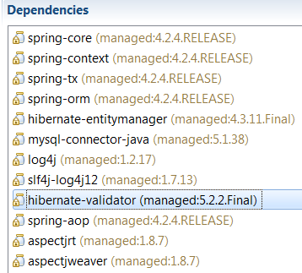
Spring Validation Config
Maven Dependency
<bean id="messageSource"
class=
"org.springframework.context.support.ReloadableResourceBundleMessageSource">
<property name="basename" value="classpath:errorMessages" />
</bean>
<bean id="messageAccessor"
class="org.springframework.context.support.MessageSourceAccessor">
<constructor-arg ref="messageSource"/>
</bean>
<bean id="validator"
class=
"org.springframework.validation.beanvalidation.LocalValidatorFactoryBean">
<property name="validationMessageSource" ref="messageSource" />
</bean>

Slide 10
Data Validation Application
Presentation
  simple input validation
  do not proceed if the input is in the wrong format
  "gate" client requests to the server to reduce round-trips, for better usability and reduced bandwidth/time
Service
  business logic and authorization
  don't let users do things they aren't allowed to do
  handle "derived" properties and state here (things that would be denormalized in the database)
Persistence
  the essential data integrity layer
  ABSOLUTELY REFUSE to store any junk

Slide 11
Main Point
Validation checks the correctness of data against business rules. This prevents problems in the business model from arising.
In Cosmic Consciousness, life is lived stress- free; problem-free

Slide 12
Constraint Composition
“Convenience” Feature
USE CASE Example:
@NotEmpty
Size(min=5, max = 9, message= "{EmptyOrSize}")
private String lastName;
For lastName = “”
2 messages:
Last name is a required field
Last name must be between 5 and 9 characters
Composition Alternative:
@EmptyOrSize(min=5, max = 9, message= "{EmptyOrSize}")
1 message:
Last Name must be between 5 & 9 characters

Slide 13
Annotation Implementation
@NotEmpty( )
@Size
@Target( { ElementType.METHOD, ElementType.FIELD })
@Retention(RetentionPolicy.RUNTIME)
@Constraint(validatedBy = {})
@ReportAsSingleViolation
@Documented
public @interface EmptyOrSize {
String message() default “Must be a value and the right size.";
Class<?>[] groups() default {};
Class<? extends Payload>[] payload() default { };
@OverridesAttribute(constraint=Size.class, name="min")
int min() default 10;
@OverridesAttribute(constraint=Size.class, name="max")
int max() default 15;
SEE DEMO Validation
Notes:
validatedBy --- custom validator logic
@OverridesAttribute – overrides the SIZE attributes..
@notEmpty == @NotNull @Size(min=1)

Slide 14
JSR 303 GROUPS
Constraints may be added to one or more groups
Groups allow you to restrict the set of constraints applied during validation.
USE CASE Scenario:
Overnight batch job loads new products with INVALID Status
If product "passes" default validation
product is set to BASIC status
& assigned to an Admin [Sean or Bill]
Admin "fixes" product
If product "passes" details validation
product is set to DETAILS status
& assigned to the Admin's Supervisor [Paul or Pete]
Supervisor "fixes" product
If product "passes" production validation
product is set to PRODUCTION status
Default group
Details group
Production group

Slide 15

Hibernate Groups Example
A Group is an interface
A group can extend another group
When validator evaluates a specific group's constraints it
also evaluates all of its super groups (interfaces) constraints.
public interface Details extends Default {}
public interface Production extends Details {}
@EmptyOrSize(min=5, max = 32, message= "{EmptyOrSize}")
private String name;
@EmptyOrSize(min=20,max=2000,message="{EmptyOrSize}",groups={Details.class})
private String description;
@NullMinNumber(value=6,message="{NullMinNumber}",groups={Production.class})
private Integer quantity;

Slide 16
Demo
Business Process Management [BPM]
BPM is designing processes, executing them across people and systems, managing tasks, and continually optimizing it all.
Workflow Management - is automation tool for directing tasks to the responsible users in a business process for further actions.
Workflow is a component of BPM, but it is more about task management and how repeatable, less complex individual processes get accomplished.

Slide 17
Demo
Workflow/Business Process
EOD Batch job Loads the products
Status set INVALID
If product "passes" default validation
product is set to BASIC status
& assigned to an Admin [Sean or Bill]
Admin "fixes" product
If product "passes" details validation
product is set to DETAILS status & assigned to
the Admin's Supervisor
Supervisor "fixes" product
product is set to PRODUCTION status

Slide 18
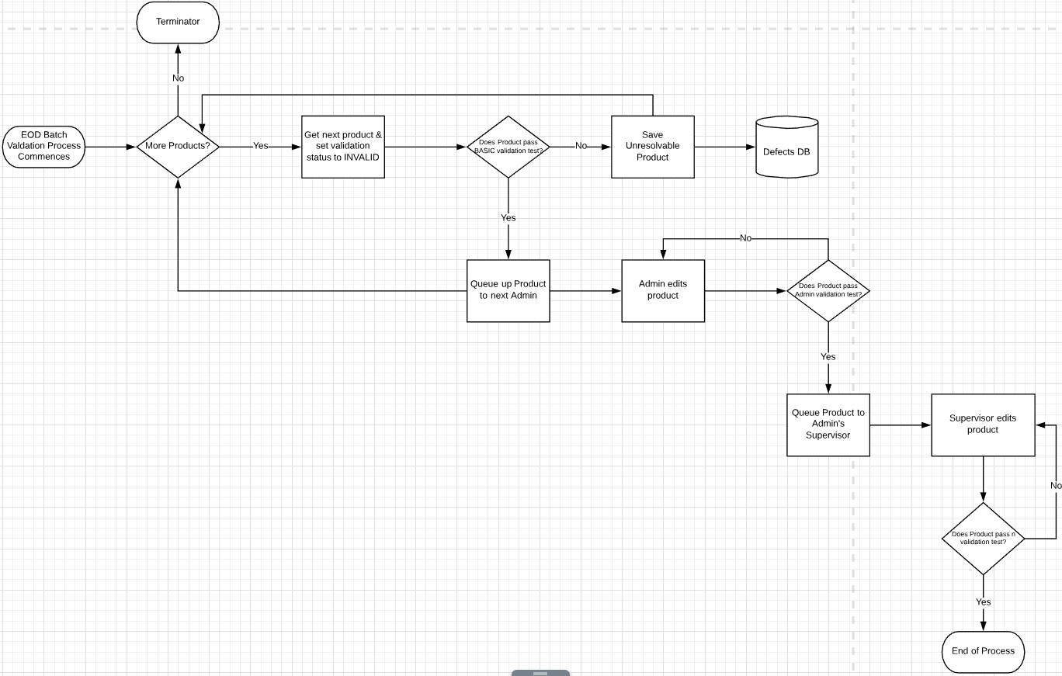
Demo Workflow Diagram
Notes:
https://www.lucidchart.com/users/login

Slide 19
Hibernate Validator
Built in to Hibernate [DIFFERENT from Spring Validator]
Last line of Defense
Entities are verified before inserts, updates or deletes are made by Hibernate.
On constraint violation – throws ConstraintViolationException
contains a set of ConstraintViolations describing each failure.
If Hibernate Validator is present in the classpath, Hibernate Annotations (or Hibernate EntityManager) will AUTOMATICALLY use it transparently.
To avoid validation even though Hibernate Validator is in the classpath set javax.persistence.validation.mode to none.
Demo Uses Hibernate Validator
BECAUSE Spring no longer supports calling Spring Validator with Group !!!
Hibernate Validator
Properties file defaults to ValidationMessages…
Notes:
Set default group in hibernate validator…

Slide 20
Demo
Validation Aspect
ServiceValidationAspect.java
@Aspect
@Component
public class ServiceValidationAspect {
//Pass in Object under validation
@Around("validate() && applicationMethod() && argsMethod(object)")
public void doValidate( ProceedingJoinPoint joinPoint, Object object)
ProductServiceImpl.java
@ServiceValidation
public void update( Product product) {
this.performUpdate(product);
SEE DEMOs ValidationGroupsBatch && ValidationGroupsDesktop
DEMO uses AOP
Notes:
We need to disable subsequent Automatic call to Validator in Hibernate
SET javax.persistence.validation.mode = none

Slide 21
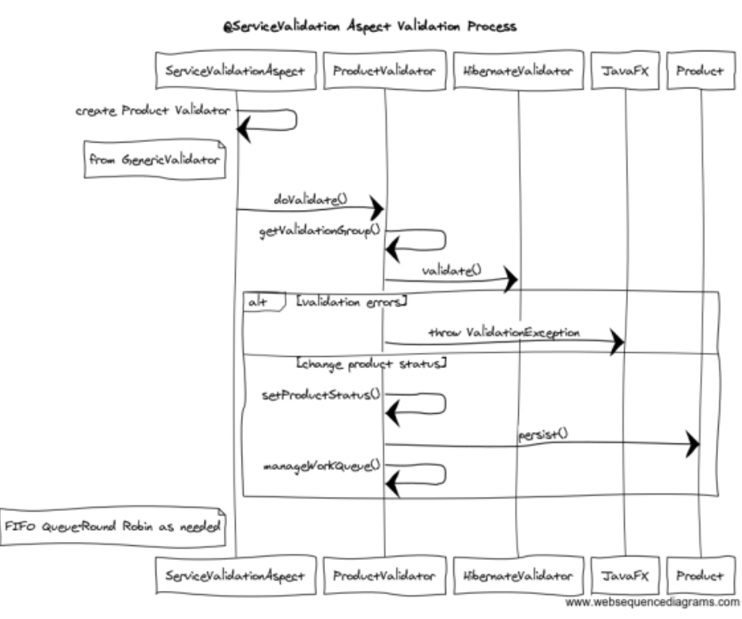
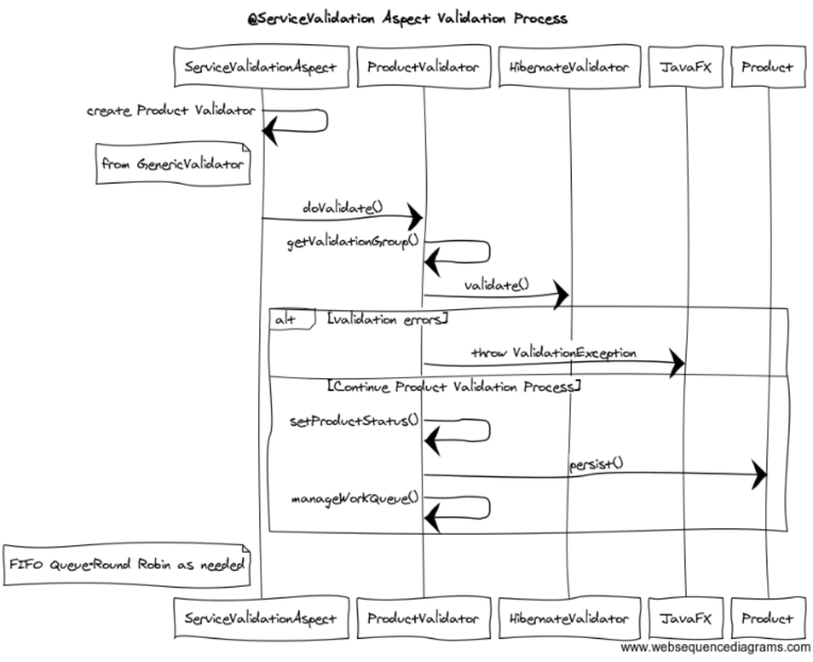
Validation Process
This is @Around Advice
Notes:
https://www.websequencediagrams.com/
@Around Advice does “Before” then Proceed then “After”

Slide 22
Main Point
JSR 303/349 validation allows for handling more complex, extraordinary verification issues with such features as Groups and Constraint Composition. A quality of Cosmic Consciousness is the ability to know what is true and right in every situation.

